Slide 1
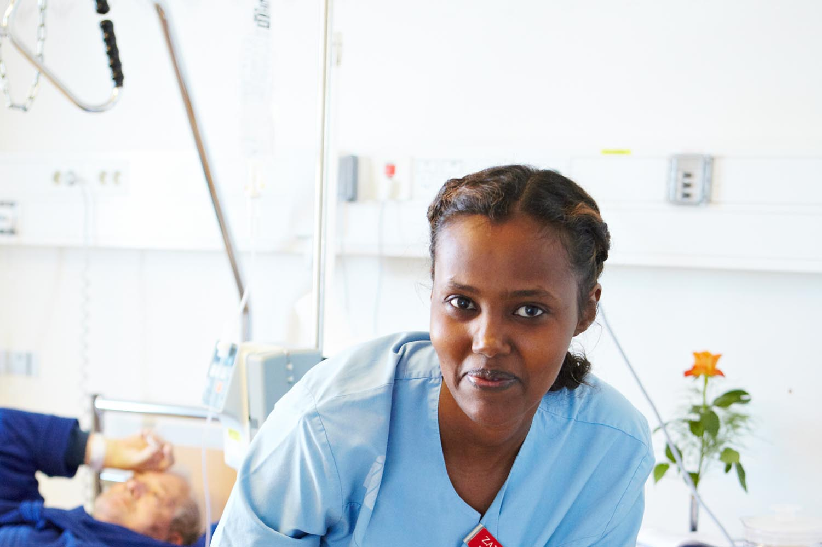
The Swedish Association of Local Authorities and Regions

Slide 2
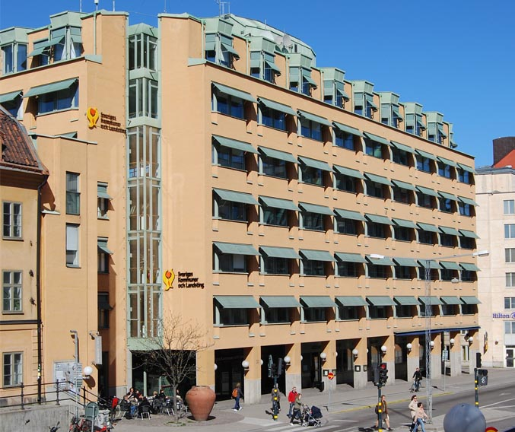
The Swedish Associations of Local Authorities and Regions (SALAR)
We are an employer’s organisation, and defend and promote the interests of our members.

Slide 3
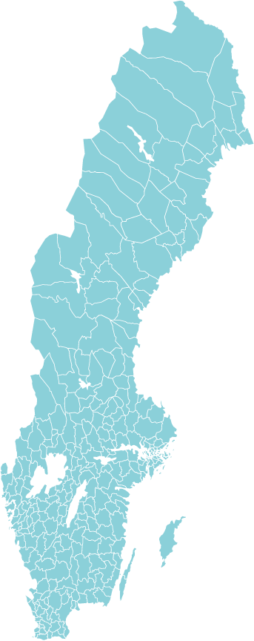
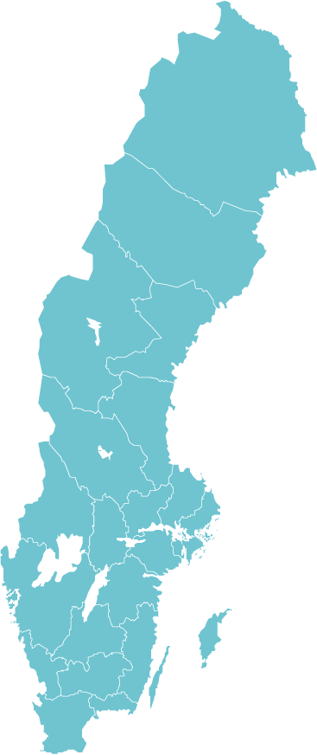
Our members
SALAR represents Sweden’s:
290 municipalities
20 county councils/regions
Notes:
The Swedish Association of Local Authorities and Regions (SALAR) represents Sweden’s 290 municipalities and 20 county councils/regions.
We act as an employer’s organisation, and we defend and promote the interests of our members, for example by working to strengthen local selfgovernment and the development of regional and local democracy.

Slide 4
Priority issues 2012
Better results in schools
Better support for vulnerable children
Jobs for young people
Better life for sick eldery people
Equality in welfare services
Reduce patient harm
Higher ambition in climate issues
Strengthen public transport in social planning
Sweden´s most important job
Simpler eSociety
Clearer mandate and cooperations between politicans and officials
Improved systems for ordering, procurement and monitoring.

Slide 5
Plug In
Plug In is one of 8 projects in Sweden with focus on reducing early school leavers/drop outs
EUR 9 million to Plug In
The projects are funded by the Swedish ESF-council with 50 %, which means EUR nearly 18 million

Slide 6
Primary goal
Referring to the main education goals of the EU “2020-strategy” to reduce school drop-outs within the Union.
The overall project goal is that early school leavers are significantly lower than 10 % by 2020.

Slide 7
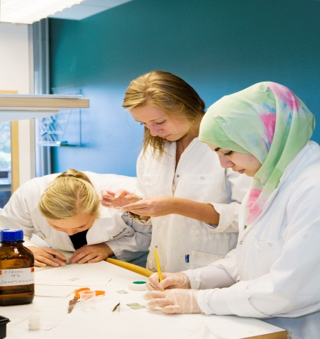
Why Plug In?
Sweden has a high rate of unemployment among people under the age of 25
Young people who have not completed secondary school hade the most difficulties finding a job
Thousands of students drop out of secondary school each year.
Many students change the study programme.
Others never finish secondary school.
We know that this leads to difficulties in entering the labor market

Slide 8
Percentage of students who do not complete secondary school
3 years | 31 %
4 years | 24 %
5 years | 23 %
Vägt medelvärde, start 2005 SCB

Slide 9
Plug In - SALAR has taken an initiative
Main goal to reduce droup-outs.
Together with five regions.
A project that approaches the challenge of early school levers/drop-outs.
Based on the increased need for development at local, regional and national level.

Slide 10
The main target group
Men and women, 16 years of age or older who:
have dropped out of, or never started secondary school
are within the training structures, but not active in secondary education.
have high absence and are at great risk to drop out.

Slide 11
Main Goals
The goal for Plug In is to halve the number of students who doesn´t finish secondary school in 4 years.
To provide all in the target group, correct and effective actions at the right time
To increase knowledge of what measures that reduce the risk for students to drop out of school
To create long-term effects and to communicate the results and experiences from the project so that all levels benefit and learn from it.

Slide 12
Partners
Swedish Association of Local Authorities and Regions (SALAR) www.skl.se
Gothenburg Region Association of Local Authorities (GR) www.grkom.se
Regional Council of Jämtland www.regionjamtland.se
The Regional Council in Kalmar County www.kalmar.regionforbund.se / Region of southern Småland www.rfss.se
Region Council of Västerbotten www.regionvasterbotten.se
East Sweden Region (Östsam) www.ostsam.se
55 municipalities

Slide 13
Today's current situation
1 mars 2012, project starts.
1 juni 2012, planning and organisation of workshops
31 augusti Workshops start in all regions
30 juni 2014 project finishes
Notes:
Project schedule: The project started in March 2012 by regions appointed which municipalities and workshops that will participate in the project. The work in this phase has been to plan and coordinate regional municipalities and workshops. In autumn 2012 start work in the workshops seriously, and will continue throughout 2013. in June 2014, the project will be completed and evaluated.

Slide 14
Workshops - examples
Cooperate with elementary school - early intervention
Efforts for health and well being
Exchange of experience /skills
Mentoring / coaching
Flexible training structures
Efforts for those who have dropped out of secondary school
Cooperation with other actors and business sector
Develop better validation methods
Better statistics
Among others……
Notes:
Examples of workshops that municipalities themselves have stated that they want to work with in projectet Plug In. The important thing is that the purpose of the workshops is ultimately to reduce losses from secondary school.

Slide 15
Notes:
The diagram shows the distribution of workshops in the different regions.

Slide 16
Plug In is included in both a national and international context
ESF requires international cooperation in all drop-out projects
Baltic Sea Region
Perhaps a Flag Ship project
Germany, Finland, Estonia, Polen….
OECD
Perform case studies, network and organizes conferences
Notes:
(från googleöversättningen av ESF-dokumentet): Transnational cooperation is a mandatory requirement for the 8 projects focusing Early school leavers/drop-outs of ESF funding. Most of the projects have indicated interest in cooperating with Member States (MS) in the Baltic Sea Region.
OECD?

Slide 17
Thank you!
Leif Klingensjö
leif.klingensjo@skl.se
Birger Eriksson
birger.eriksson@verksamhetslyftet.se

